Slide 1
EMPLOYEE DATA ANALYSIS USING EXCEL
STUDENT NAME: kaviya.s
REGISTER NO:312204807
DEPARTMENT: B.COM GENERAL
COLLEGE : THIRUMURUGAN ART AND SCIENCE COLLEGE FOR
WOMEN NAN MUDHALVAN ID :asunm217312204807

Slide 2
PROJECT TITLE
Employee classification and salary Analysis using Excel

Slide 3


AGENDA
Problem Statement
Project Overview
End Users
Our Solution and Proposition
Dataset Description
Modelling Approach
Results and Discussion
Conclusion
3/21/2024 Annual Review

Slide 4

PROBLEM STATEMENT
1.Summary statistics (e.g., average count, median, mode)? 2. Data visualization (e.g., bar chart, pie chart)? 3. Filtering or sorting the data? 4. Identifying trends or patterns? 5. Something else?
 |  | e.
For example
PART- TIME AND FULL- TIME, CONTRACT

Slide 5

PROJECTOVERVIEW
General Employee analysis is a systematic process used by organizations to evaluate various aspects of their workforce. The goal is to understand employee performance, skills, needs, and overall contribution to the organization
.
Data collection
Data cleaning
Data collection

Slide 6

WHO ARE THE END USERS?
Industrial sector
Employee and employer
IT sector
Organization
Management

Slide 7

OUR SOLUTION AND ITS VALUE PROPOSITION
Pivot Table : In the PivotTable Field List, drag and drop fields into one of four areas: Rows, Columns, Values, and Filters.
Bar Chart: Graphics in Excel enhance data presentation and help visualize trends, patterns, and comparisons.

Slide 8
Dataset Description
Employee data set – kaggle Total features 26 1.Gender –female and male 2.State – TN,AP,etc 3.Classification of employee – Part-time ,Full-time ,Contract. 4.Departments – Accounting, IT, Sales manager ect…

Slide 9

THE "WOW" IN OUR SOLUTION
we Identify a number of Employee work in a each of department for example Accounting, BI Director, Administrative assistant, network design Ect…….
3/21/2024 Annual Review
9

Slide 10
MODELLING
1 . DATA COLLECTION 2 . DATA CLEANING 3.TECHNIQUES i. Filter – missing values ii. Topic – identify a topic iii. Clearing – blank values 4. PIVOT TABLE 5. CHART GRAPHS
10

Slide 11
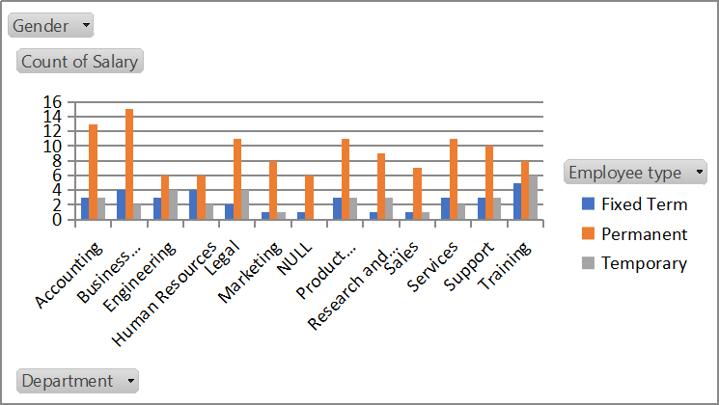
RESULT
11

Slide 12
conclusion
1.The final Result is most of the workers are PART –TIME Employee in DATA ANALYST . 2.than the least of worker in DATA ANALYST in contract employee. 3. The equal of performance in ACCOUNTING in each of part-time ; and full- time ; contract workers

Slide 13
THANK YOU

